Slide 1
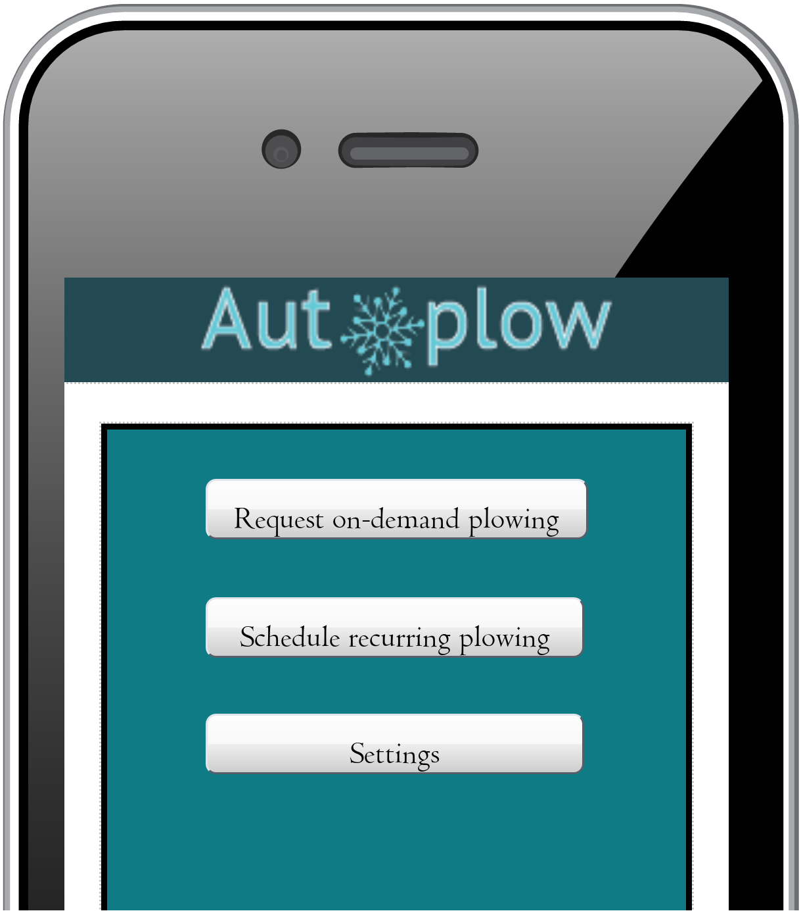
AutoPlow
By: Ezra Estey & Elliot Chandler

Slide 2
Problem statement
Too often, many people have to scroll through different websites to find the best plowing professional to get their snow removed.
Comparing prices, seeing if the plow driver is trustworthy or not, etc. is time consuming and can be frustrating.

Slide 3
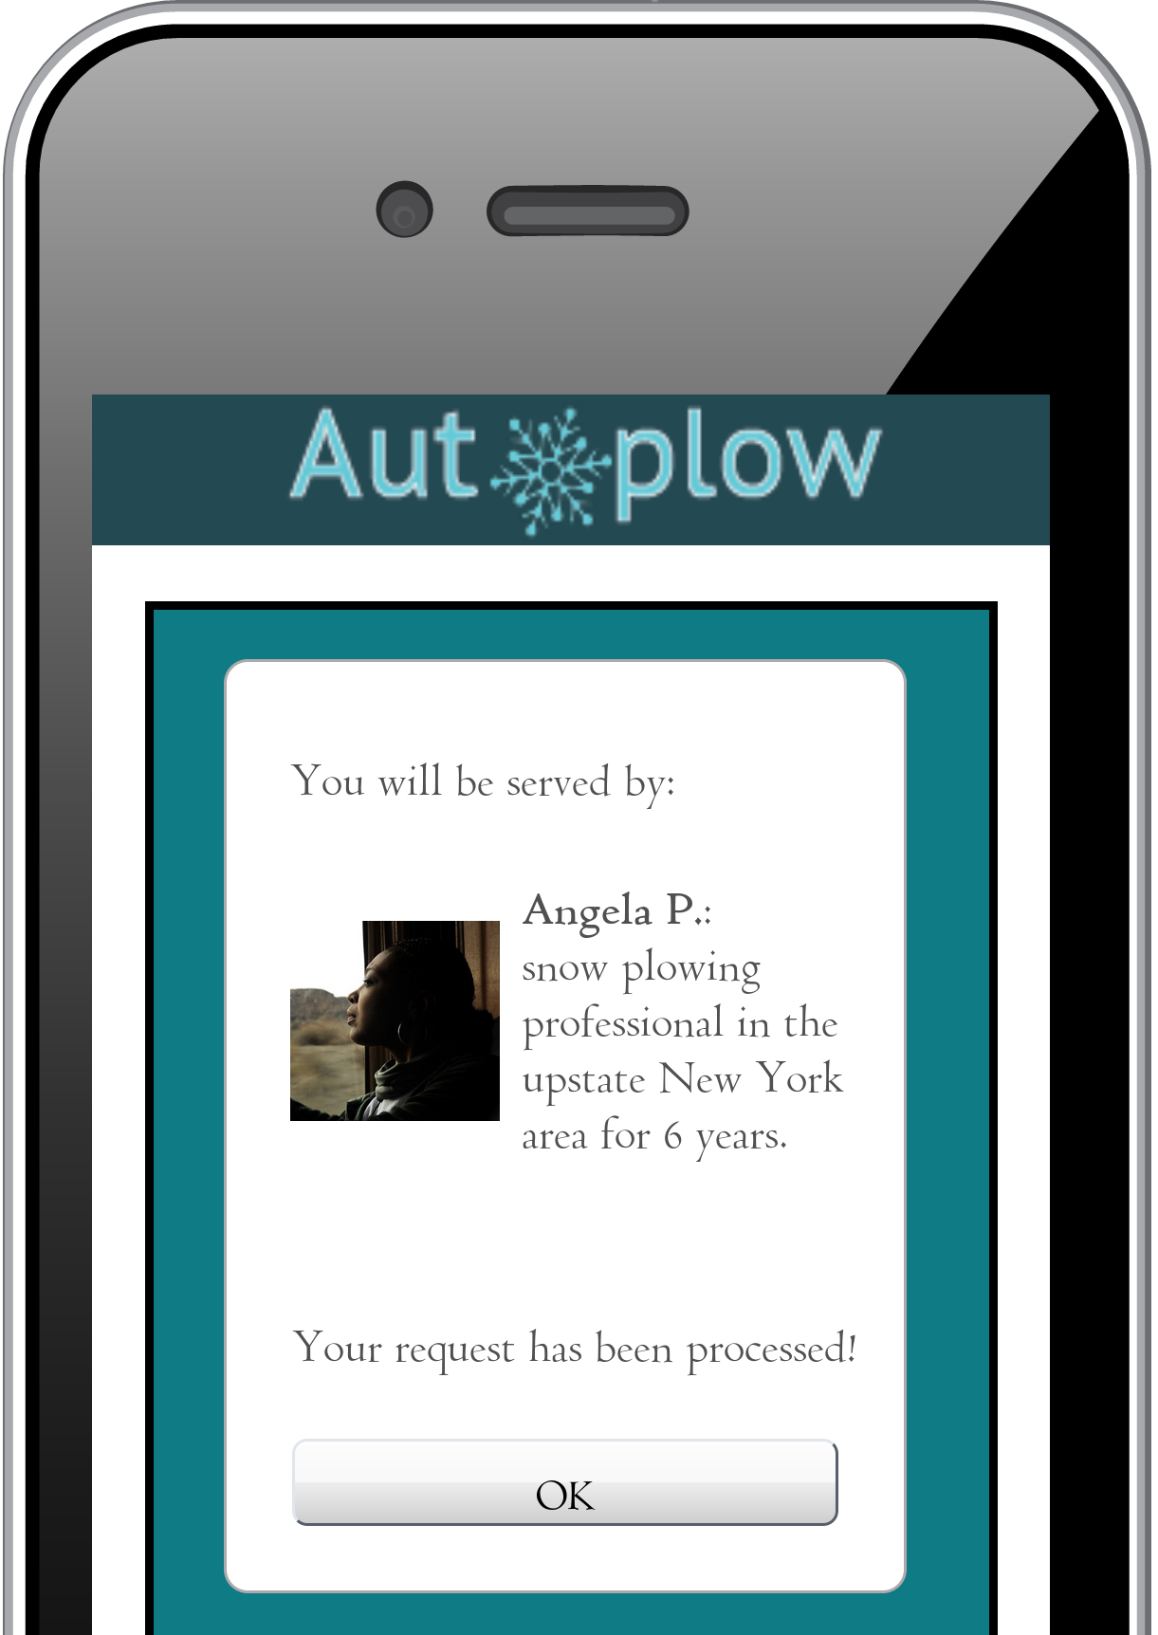
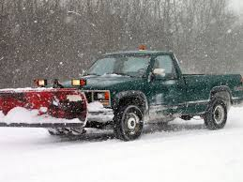
Solution: With the AutoPlow app, people can request for a driver, and then the app will find the closest driver in their area.

Slide 4

User Interviews: We interviewed multiple plow drivers in Maine and their response to whether or not they would use a snow plowing app was yes, as long as they didn’t have a route already.
Most came to the same conclusion that the app would make their jobs more efficient and have less hoops to jump through.

Slide 5
Details of App: When you first open the app, you can choose whether you want the driver to come at a scheduled time every week or if the need is urgent.
No longer is there a lengthy process on sites like HomeAdvisor where you have to put in a bunch of information and talk to someone on the phone.

Slide 6
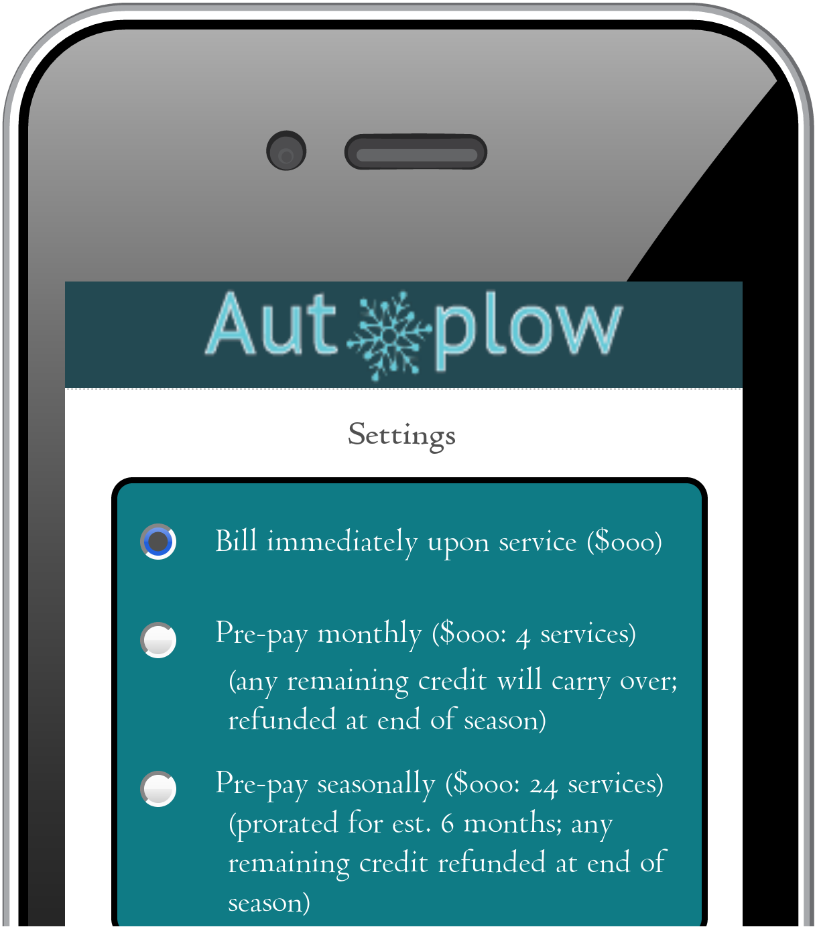
Details of App: Next you choose your payment preference, whether you want to pay for a full season’s worth at once, or pay per visit.
There are pros and cons to both.
Based on data collected by HomeAdvisor, the average cost to get your driveway plowed is between $133–187 per visit.
On the app, there is the payment option that makes paying quick and easy.

Slide 7
Persona Example:
Elliot is a ski instructor and they need to get to their class at 6am.
Instead of jumping through hoops online for a snow plowing professional to arrive, they can request for a driver, and then the app will automatically find the closest one available.

